Slide 1
Project 1: S&P 500 Analysis
Jacob Merjan
Rajiv Manglani
Vishwa Angampalli
Joe Scuteri

Slide 2
Agenda
Purpose of the Project
Resources & Software
Data Manipulation and Calculations
Data Visualizations
Final Implications
Notes:
(Joe)

Slide 3
Purpose
Analyzed the annual performance of S&P 500, their sectors and the largest company per sector over a fixed span of time and found correlation with three market indicators.
Market indicators are :
CBOE Volatility Index (VIX) – Measuring volatility over upcoming 30 days
10 Year Treasury Rate Change – Influences borrowing and mortgage rates
Price of Gold (oz.) – inverse relationship between USD and stock market
Notes:
(Joe)
Give normal terms of the VIX. / 10 Year / Price of gold
VIX a real-time market index representing the market's expectations for volatility over the coming 30 days. Can be due to any factor.
Price of gold is an inverse relationship between the USD and stock market
10 Year Treasury Rate: The 10-year Treasury yield serves as a vital economic benchmark, and it influences many other interest rates. When the 10-year yield goes up, so do mortgage rates and other borrowing rates

Slide 4
Resources & Software
Resources Yahoo Finance
Price information for S&P 500 Index
Price information for 9 of the 11 sectors within the S&P 500 Index
Real Estate & Communications Sector created after 1999
Price information of 9 top performing companies within each sector
Software
Python Jupyter Notebooks
Pandas
Matplotlib
Notes:
(Joe)
9 of 11 RE and Communications came out post 1990

Slide 5
Data Manipulation and Calculations
Import CSV files
Left merge based on date (month)
Using loc & iloc
Setting index by year and formatting to Datetime
Percent Change Year-Over-Year calculation
Plotting and visualization
Notes:
(Joe)

Slide 6
Data Visualizations for S&P 500
Annual performance
Market indicators compared against S&P 500
Sector performance
Individual top performing companies
Notes:
(Rajiv)

Slide 7
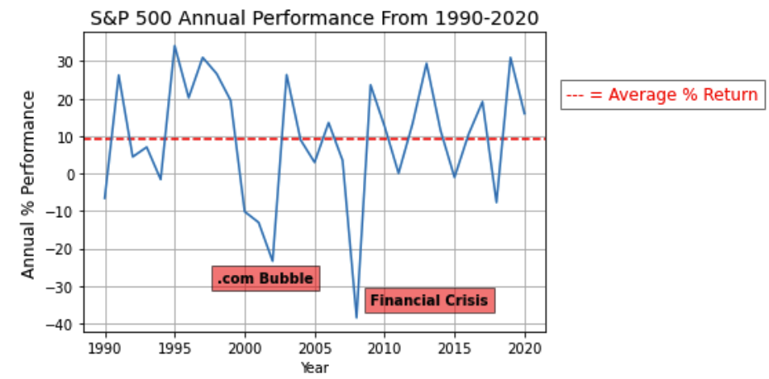
S&P 500 Annual Performance
Two major drops
Dot.com bubble & Financial Crisis 2008
Roughly a 10% average return per year over this time period
Notes:
(Rajiv)
- We plotted the S&P 500 annual performance from 1990 to 2020.
- (Open Price first year - Open Price following year)/(Open first year)

Slide 8
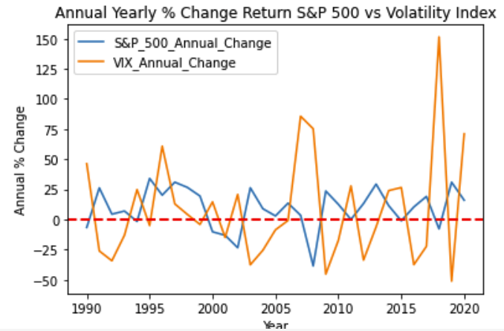
S&P 500 vs. CBOE Volatility Index (VIX)
The level volatility did not have a direct correlation to the performance of the S&P 500
R-Value: 0.2157
Notes:
(Rajiv)
(Skip in presentation, but touch that it was analyzed)
VIX as an indicator of insecurity in the market. Usually during elections which the VIX increases.

Slide 9
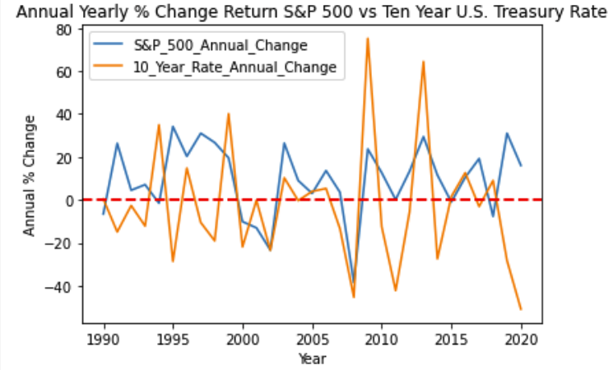
S&P 500 vs. 10 Year Treasury Rate Change
The 10 Year Treasury Rate did not have a direct correlation to the performance of the S&P 500
R-Value: 0.07
10 year treasury are reactive to how the economy is going. Therefore, they are very “related”.
Notes:
(Rajiv)
10 year treasury are reactive to how the economy is going. Therefore, they are very “related”.

Slide 10
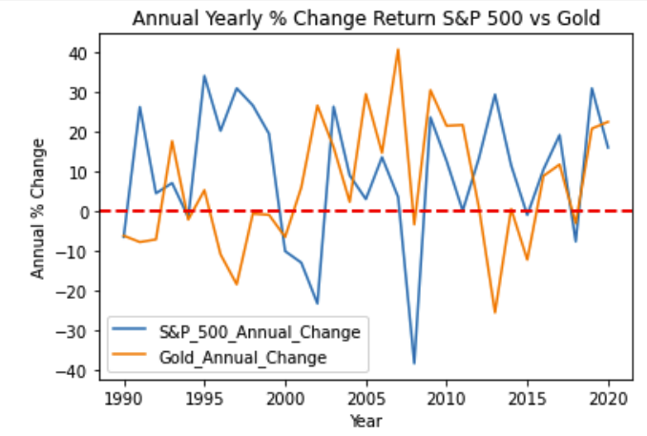
S&P 500 vs. Price of Gold (oz.)
Average rate of return for gold during this time period was 6.2% (comparatively to ~10% for S&P 500)
Inverse relationship 2003, 2008, 2013
Market wide crash 2008
Notes:
(Rajiv)
Average rate of return for gold during this time period was 6.2% while the S&P is 9.36%
Inverse relationship – when economy does poor, people tend to invest in gold
In 2003, when S&P was low, the price of gold was high – dot com bubble
In 2013, when S&P was low, the price of gold was high – market recovery
In 2008, both the S&P and Gold fell due to an overall crash, but gold was still more stable than S&P – recession
The value of gold did not have a direct correlation to the performance of the S&P 500
R-Value: 0.004
S&P fell in 2003 and 2008
Gold dropped during 1997 & 2013

Slide 11
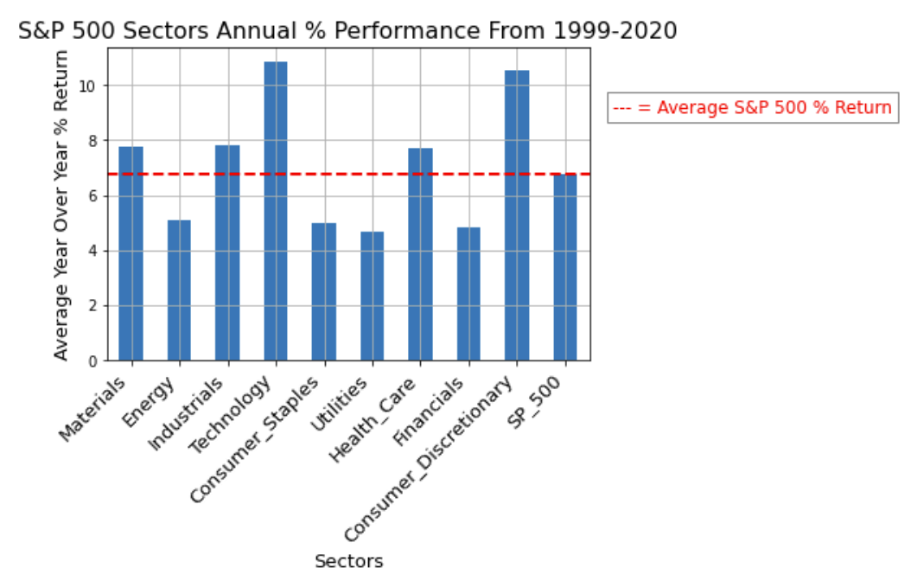
S&P 500 - Sector Performance
Analyzed overall performance S&P 500 by sector
S&P return was 6.71% during 1999-2020
5 industries outperformed the S&P 500
Notes:
(Joe)
S&P Return was 10% between 1990 - 2020 but from 1999 it was 6.71%
5 Industries
Materials
Industrials
Technology
Health Care
Consumer Discretionary
Technology always on the rise with large tech companies taking over the world. Online dating, Zooms etc.

Slide 12
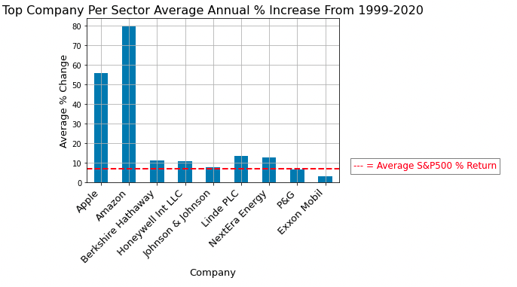
S&P 500 - Largest Companies from each Sector
Analysis of the largest companies per S&P 500 sector
Apple and Amazon two highest performing within their respective sector
Notes:
(Vishwa)
Largest companies from each sector ETF
EFT: Basket of securities
Mention surprise that amazon is not tech – something Jeff bezos
Apple (Tech) and Amazon (Consumer Discretionary) are good examples of why their respective sectors are doing so well
Most other companies outperformed S&P
Try and mention the 6.71

Slide 13
Implications
With the ~10% return in the S&P 500, if you $100 invested in 1990, you would roughly have $1,700 by 2020
The correlation coefficient for market indicators did not help us because it accounted for only 1990 and 2020
General trend analysis can be interpreted to see market behaviors
Materials, Industrials, Technology, Healthcare, and Consumer Discretionary have outperformed the S&P between 1999-2020
Within the largest companies per sector within the S&P 500, 6 have outperformed the S&P 500 with Apple and Amazon leading performance
Notes:
(Vishwa)
$100 invested in the S&P 500 would roughly $1700
The Correlation that we learned in class didn’t help us analyzing relationship between S&P and market indicators, whereas analyzing year over year trends was more effective to see market behaviors
Thank you for listening to our presentation , any questions?

